Slide 1
Sequence Diagram
Customer Account

Slide 2
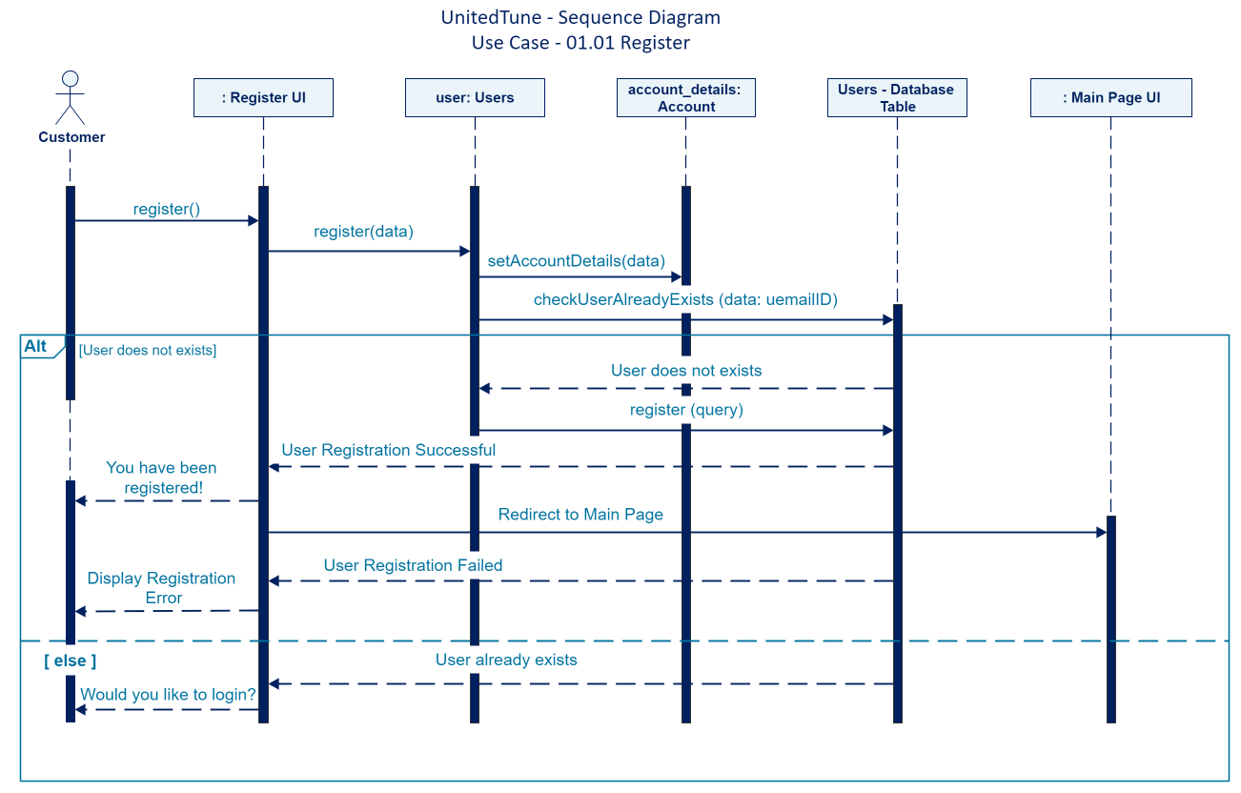

Slide 3
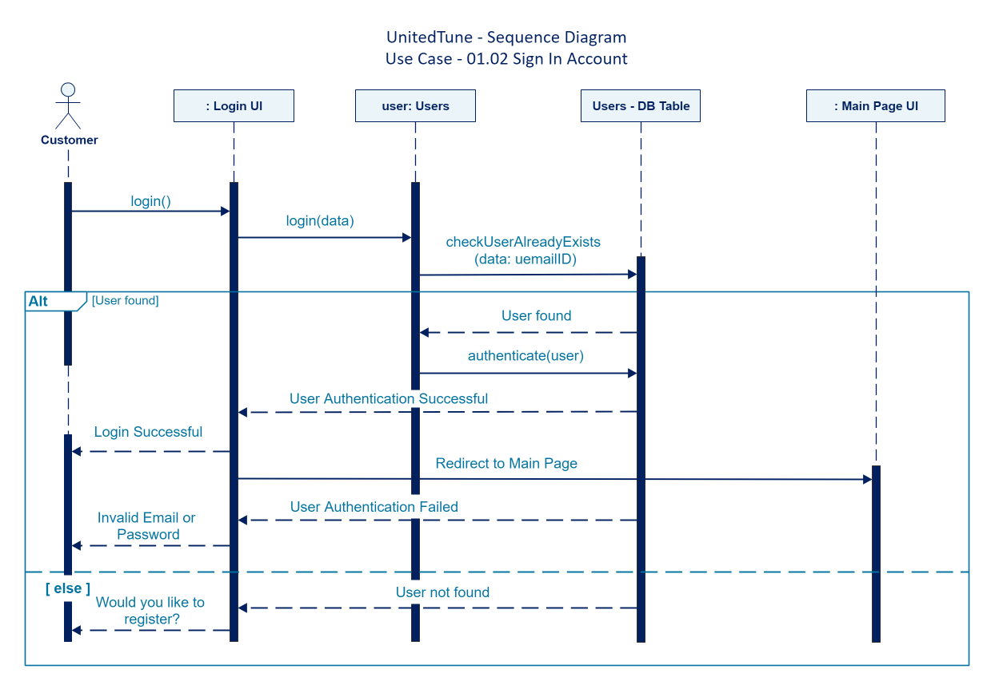

Slide 4
Sequence Diagram
02. Musician Account

Slide 5
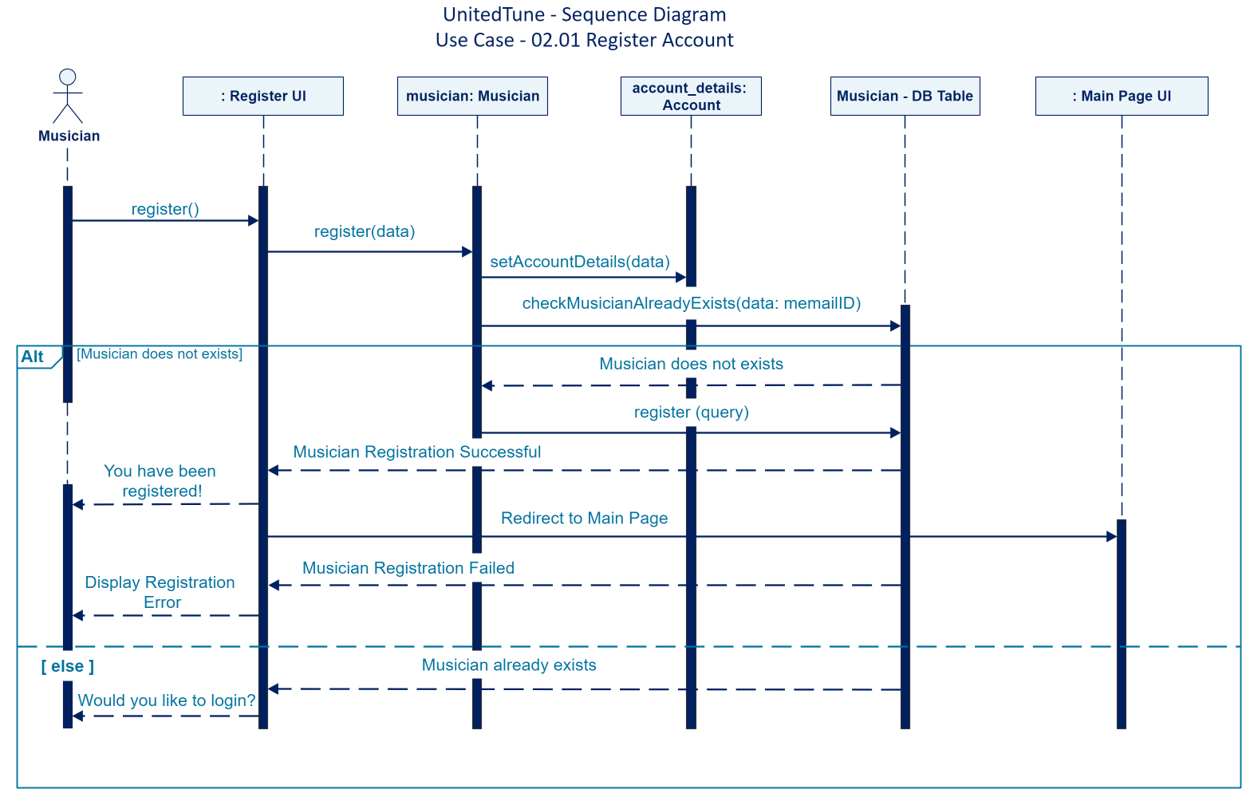

Slide 6
